Slide 1
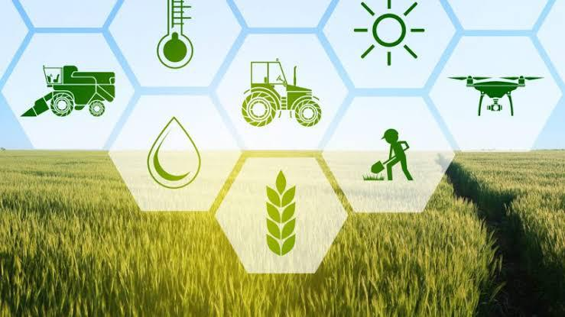
Solving farmers queries using chatbot
EXPERIMENTAL INVESTIGATIONS

Slide 2
As information plays very crutial role if we use technology in agriculture to help farmers by giving information through question and answering system which is a chat bot which is trained in different natural languages, with good user interface is very useful for farmers as it solves many queries like information of land fertility ,water availability ,crop rotation, agriculture officers and factories nearby ……etc

Slide 3
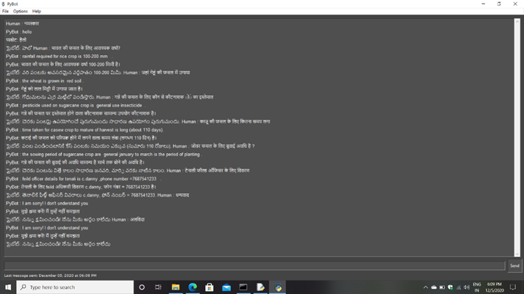
Languages
Farmers are facing many problems because of lack of informantion about agriculture. A chatbot which can help farmers by giving correct information regarding farmers queries will change the approach of farmer to agriculture.
As information plays very crutial role if we use technology in agriculture to help farmers by giving information through question and answering system which is a chat bot which is trained in different languages.

Slide 4
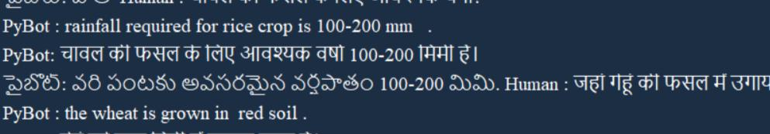
Weather
Because of less information about resources like rainfall causes heavy damages to farmers in agriculture field, they don’t know about required rainfall for a particular crop they are facing many problems.

Slide 5
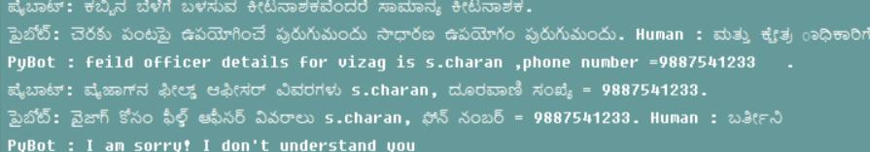
Field officers details
Every farmer should know details of agriculture officers in their locality because farmers should test their soil in their land for planting a suitable crop. In case of any damage by nature farmers have to inform to the officers and get benefits from the government under different schemes.

Slide 6
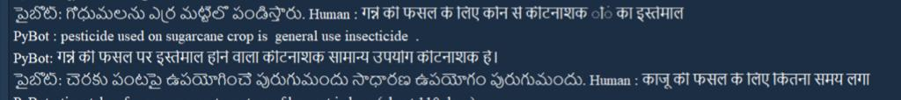
Diseases
After the plantation due to lot of bacteria and insects crops may damage then if farmer interacts with chatbot it will suggest certain things to get out of the diseases by suggesting pesticides and insecticides.

Slide 7

Crops details
Farmers have to know complete details about crops which they want to grow, the details like soil type, location.
Also they have to know time taking for a crop to grow particular crop on their land.

Slide 8
Thank you

